Slide 1

Gender, Roles & Careers: Exploring Congruity Theories
Rashi Gupta
2024 September 26

Slide 2

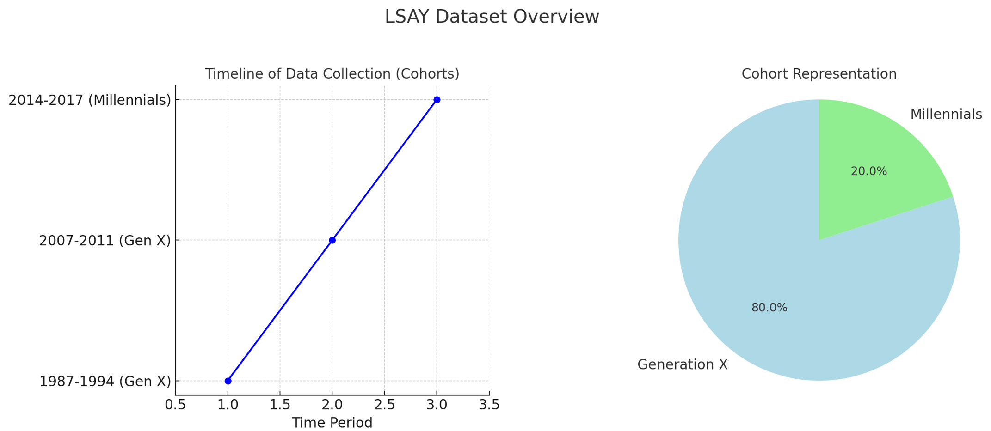
Let’s talk about the dataset ? (LSAY dataset)
- Longitudinal Study of American Youth
2

Slide 3
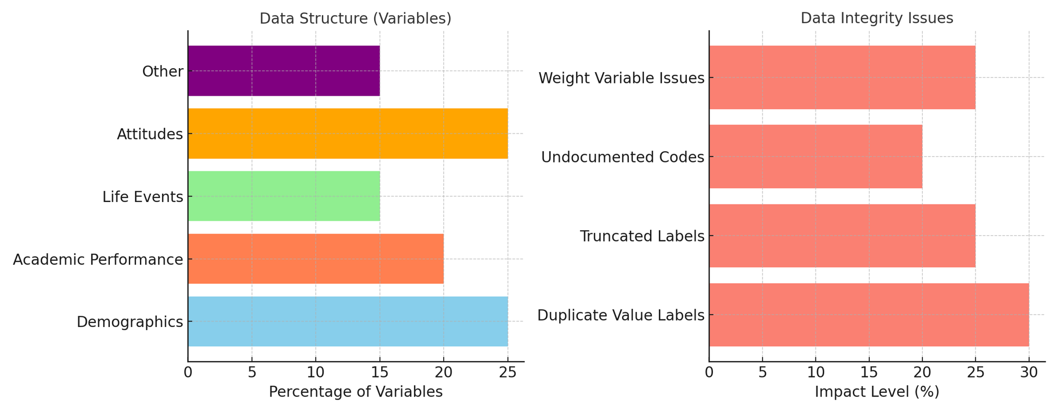
Let’s talk about the dataset ? (LSAY dataset)
3

Slide 4
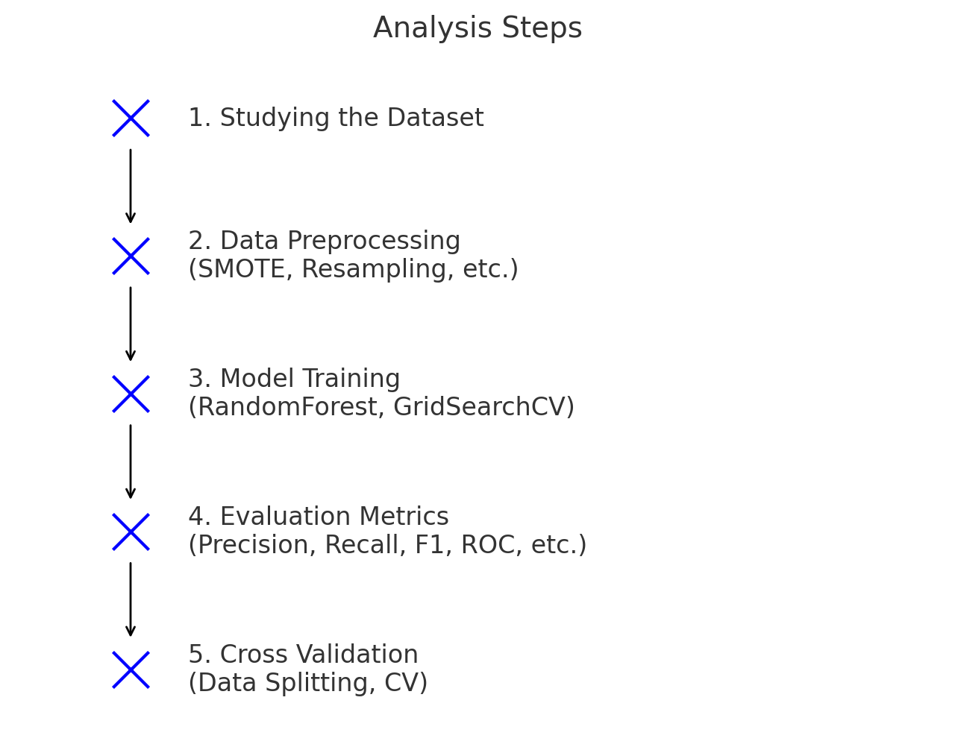
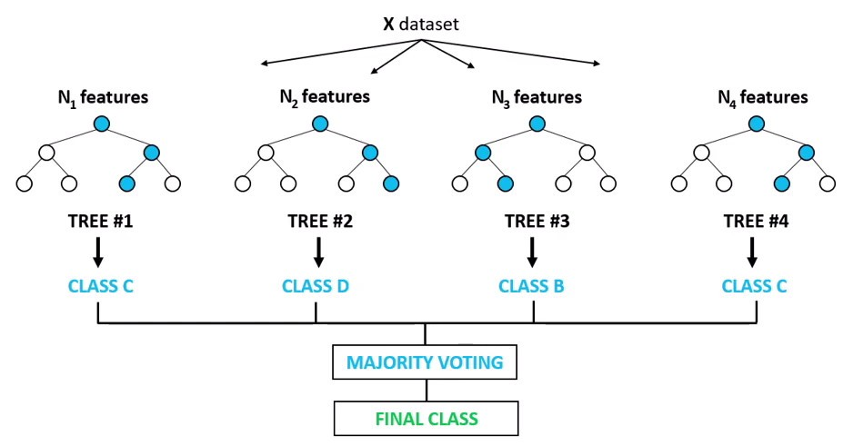
Steps Involved:
4
Random Forest algorithm

Slide 5
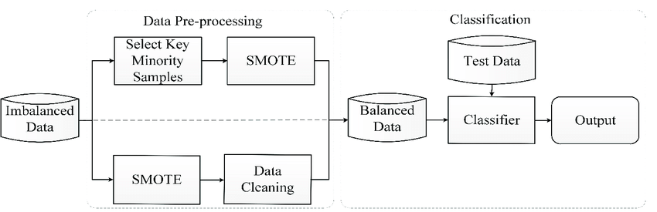
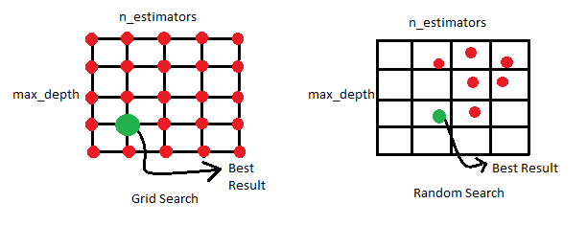
<-- SMOTE-For handling Class Imbalance
Grid Search CV →
5

Slide 6
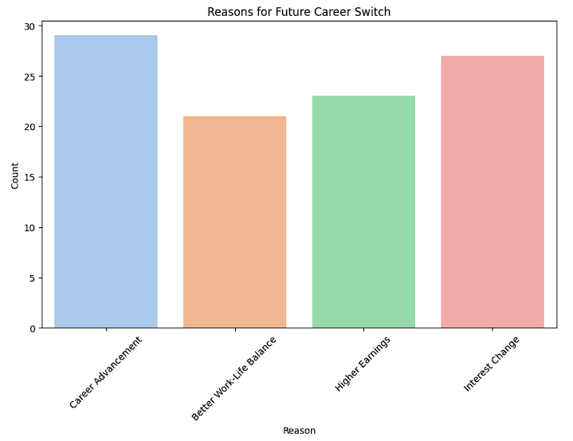
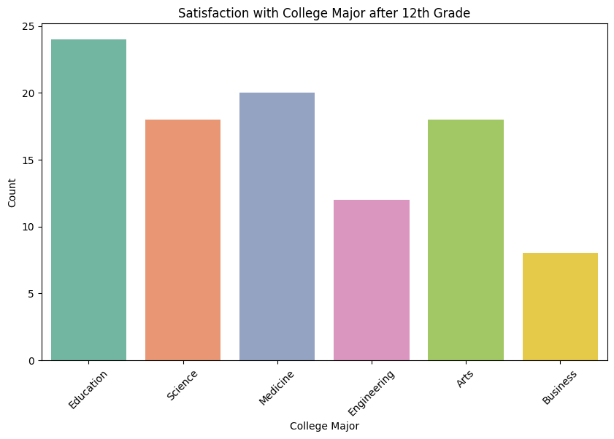
Key Findings :
6

Slide 7
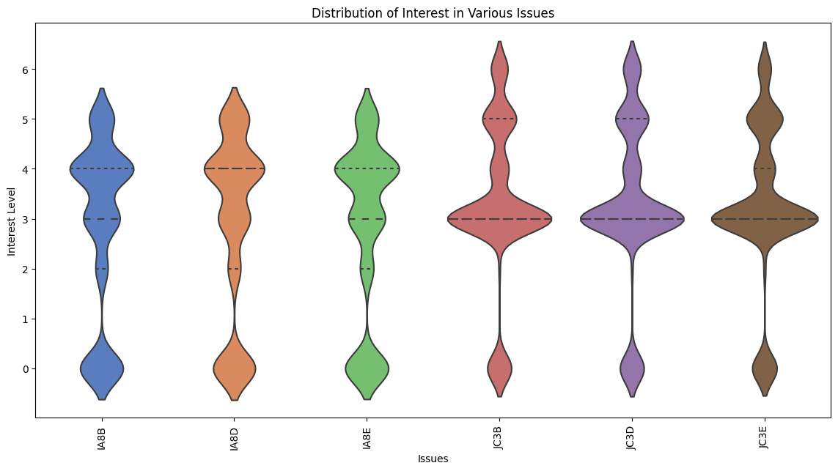
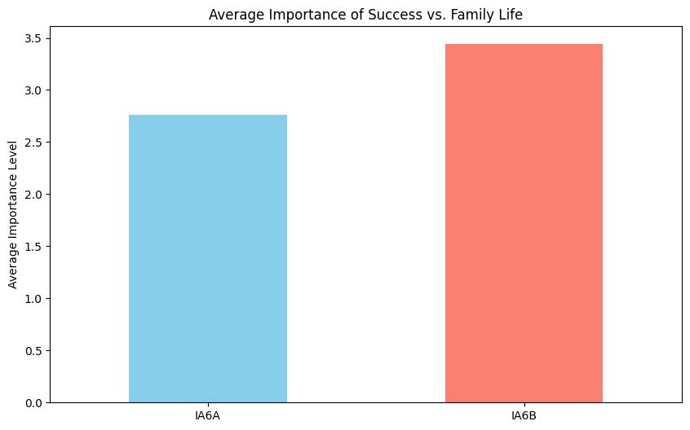
Key Findings :
7

Slide 8
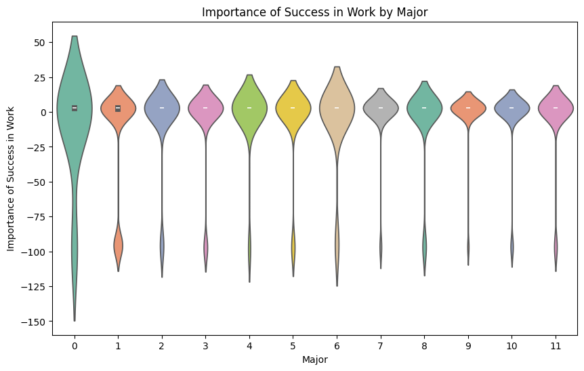
Key Findings :
8

Slide 9
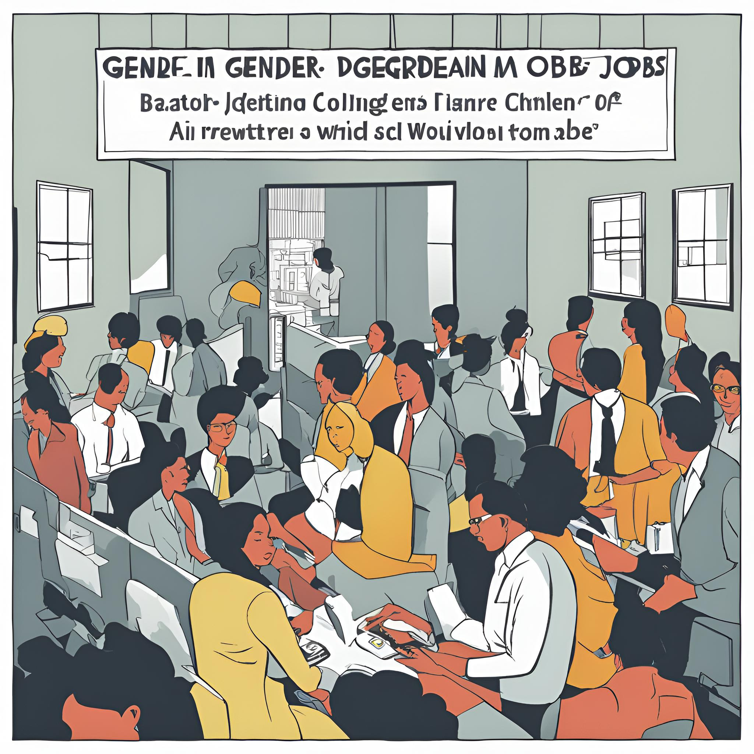
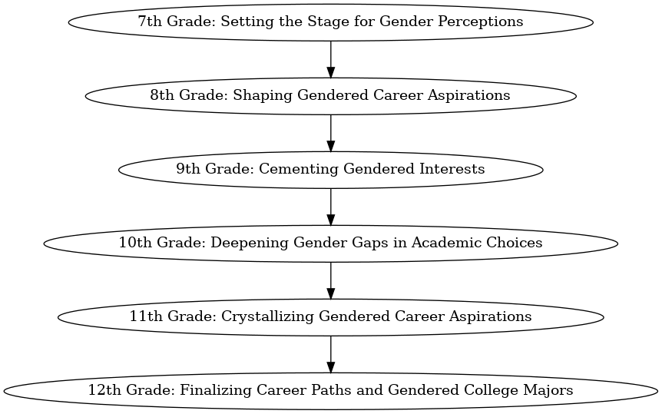
Key Points for Each Grade

Slide 10

Thank you
for listening!
Rashi Gupta
2024 September 26

